Slide 1
Brain Tumor Classification Using Deep Learning
(Group Id:02)
Ankita Kadam Guide Name:
Sartaj Bhuvaji Mr.Santosh Nagargoje
Prajakta Bhumkar
Sameer Dedge

Slide 2
Introduction
The WHO classifies Brain Tumor on a scale of Grade I to Grade IV.
These Grades classify as Benign (Non - Cancerous) and Malignant(Cancerous).
A Pituitary Tumor is a Benign tumor that starts in the pituitary gland.
This is a 4 class problem.

Slide 3
Problem Statement
To Detect and Classify Brain Tumor using CNN as an asset of Deep Learning.

Slide 4
Objectives
To identify if the MRI image of the patient has Brain Tumor or not.
If Yes, classify the brain tumor into three types, as follows:
Benign Tumor
Malignant Tumor
Pituitary Tumor
Treatment Planning.
To maintain patient records for further analysis.

Slide 5
Literature Survey
Number | Research Papers/Journal | Authors | Technologies | Comments/Analysis/Problems
1 | Diagnosing and Segmenting Brain Tumors and Phenotypes using MRI Scans | Samuel Teicher, Alexander Martinez | Machine Learning | Binary Classification (Presence of Tumor or not)
2 | Brain Tumor Segmentation with Deep Neural Networks | Mohammad Havaei Axel Davyb , David Warde-Farleyc , Antoine Biardc | Deep Neural Network | Analysis on Glioblastomas (Single Tumor Analysis)
3 | Brain Tumor Segmentation Using Deep Learning by Type Specific Sorting of Images | Zahra Sobhaninia, Safiyeh Rezaei, Alireza Noroozi, Mehdi Ahmadi, Hamidreza Zarrabi, Nader Karimi, Ali Emami, | Convolutional Neural Network | Sorting Of Images 1. Sagittal View 2.Axial View 3.Coronal View
4 | Brain Tumor Classification Using Convolutional Neural Networks | J. Seetha, S. Selvakumar Raja | Convolutional Neural Network | CNN Based Classification

Slide 6
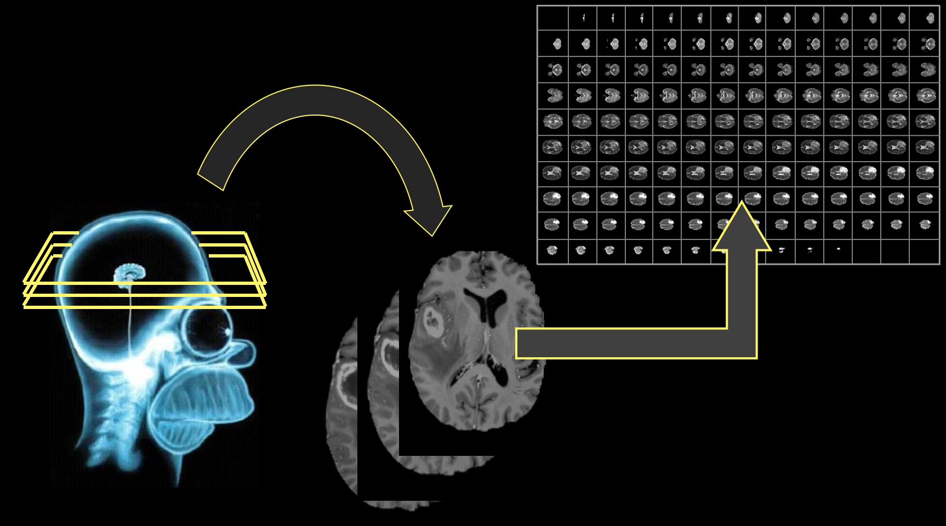
Procedure: Using CNN
Collecting Data

Slide 7
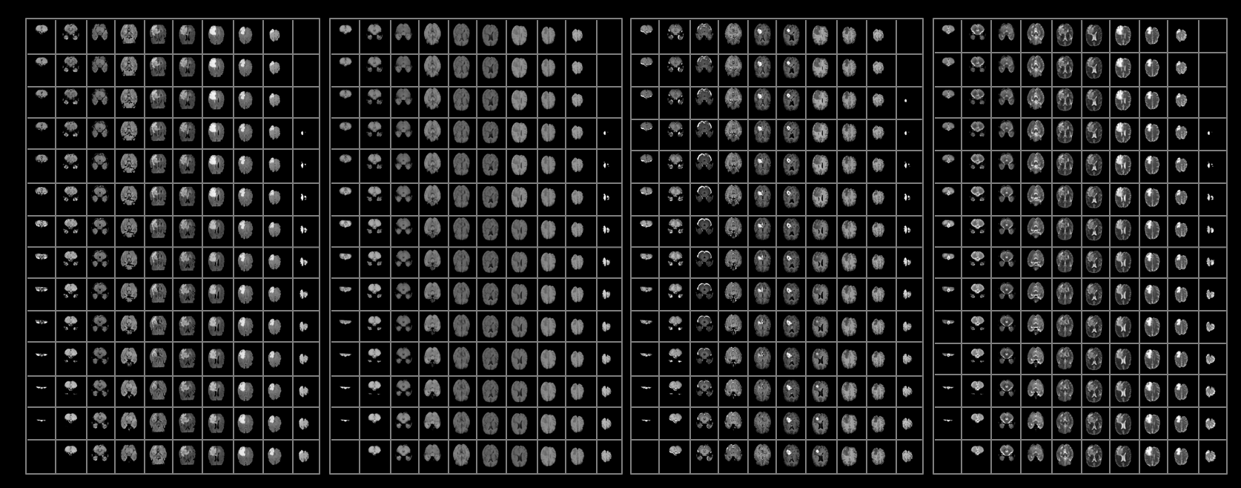
2. Segregate data into classes.

Slide 8
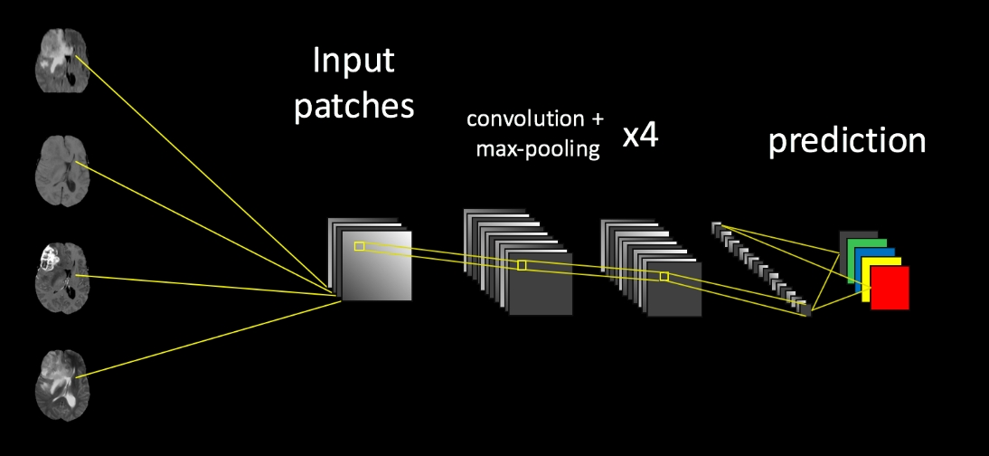
Building the network

Slide 9
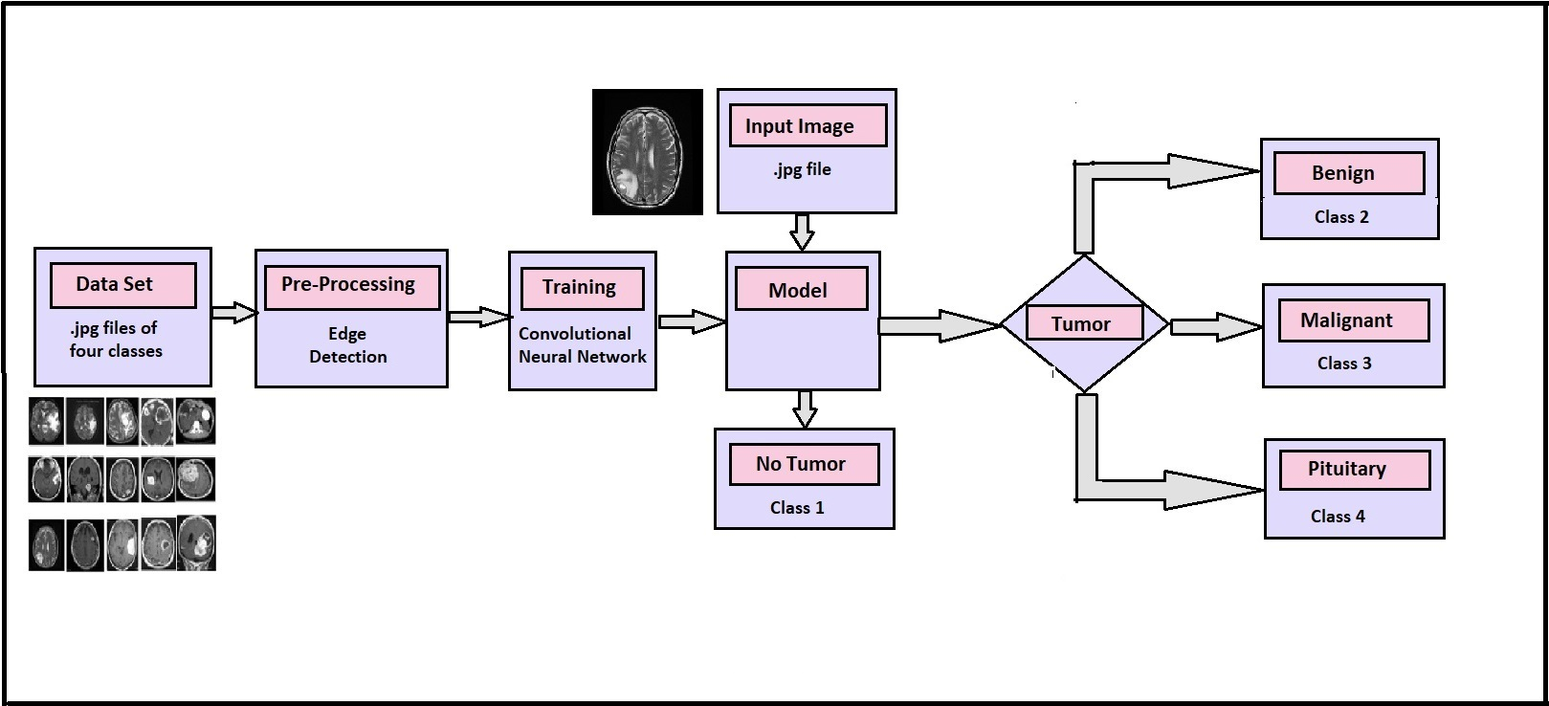
Architecture Diagram:

Slide 10
Architecture Diagram:
.jpg file
Benign
Input Image
.jpg files of
four classes
Edge detection
CNN
Tumor
Data Set
Pre-Processing
Model
Malignant
Training
1
0
No Tumor
Pituitary

Slide 11
Future Scope
Improved Diagnostics.
Covering more number of classes of Brain Tumor.
Accurate Growth Rate Prediction of Tumor.
Reduction in Medical Negligence.

Slide 12
References
https://github.com/naldeborgh7575/brain_segmentation
http://biomedpharmajournal.org/vol11no3/brain-tumor-classification-using-convolutional-neural-networks/
https://www.nitrc.org/projects/ibsr/
https://figshare.com/articles/brain_tumor_dataset/1512427
Brain Tumor Classification Using Convolutional Neural Networks J. Seetha1 and S. Selvakumar Raja2
https://github.com/Swati707/brain-tumor-classification/blob/master/PresentationAppendix.docx

Slide 13
Data Sets
https://github.com/Swati707/brain-tumor-classification/blob/master/PresentationAppendix.docx
https://github.com/naldeborgh7575/brain_segmentation

